Slide 1
The A Team
Introducing
Stanley Mohlala
Judith Matlala

Slide 2

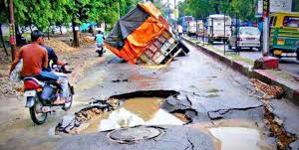
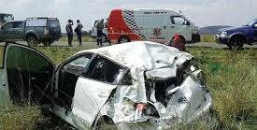
Problem Statement
The covid 19 pandemic brought with it many challenges in 2020, especially in the developing countries, Business have also had to adapt to using digital technology or face being left behind, many businesses find themselves without the necessary digital technology to reach clients.
Tackled problem Statement : Social Network and Community
Over 42000 people have died due to the faults such as potholes
Story of a Emalahleni(Witbank) community complaining that their city doesn’t fix potholes.
Currently they have to report issues on service delivery(potholes) via email and phone calls .

Slide 3
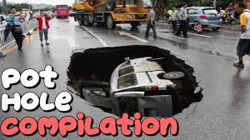
Solution
Our solutions involves
Easy access digital platform that caters : Citizen, Municipality, Suppliers
A web Application that allows Citizens to report Road faults without the need to loggin
Platform for municipality to communicate with their suppliers
Easy payment from municipality to the suppliers with the use of yoco API
Engaging platform with Citizen such news and alerts on the latest development, traffic etc.

Slide 4
Citizen
Suppliers
Municipality

Slide 5
Citizen flow
.
View the complaint
Approve or reject
Assign the nearest suppliers
Yoco payments to supplier
Supplier completes and send bill.
SMS send
Full names
Cell Number
Complaint Type
Location
Insert Picture
Submit

Slide 6






Stacks Used

Slide 7


Break down of the Project
Find solution to the problem statement
Research about the possible solution
Breakdown the project into : Citizen , Municipality and suppliers
Create the ui
Implement front end
Implement back end
Connect to yoco API

Slide 8
Completed and To Do
Front end flow
Can lodge a complaint
Map
Back end flow
Setup the database
Yoco API

